Slide 1

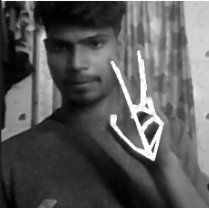

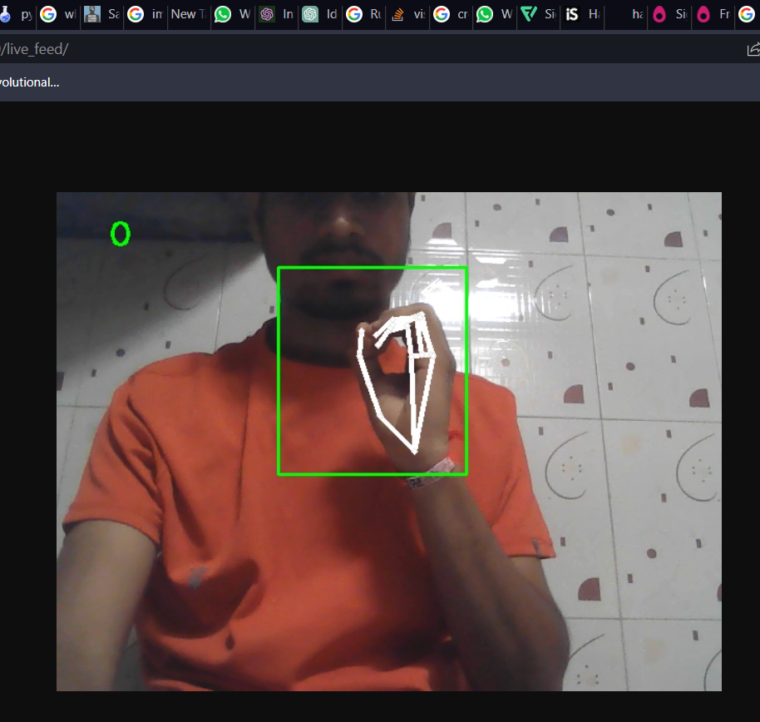

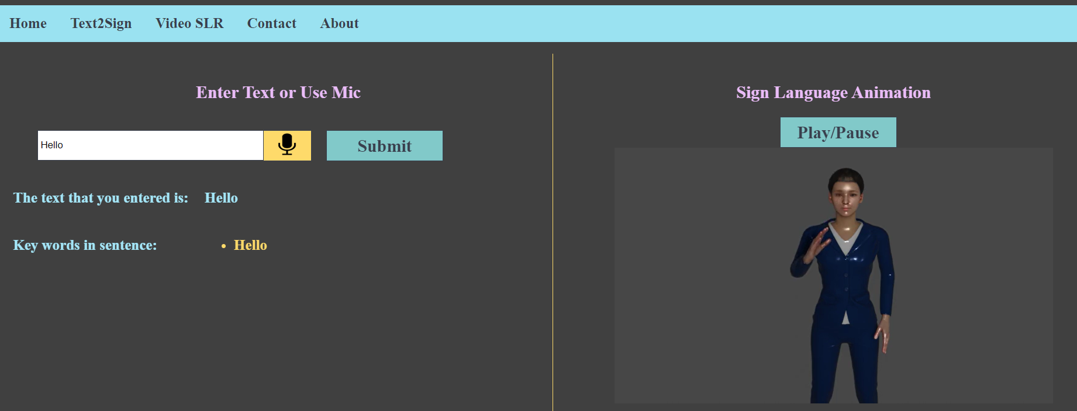
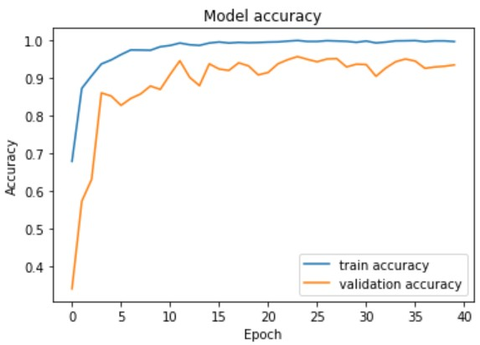
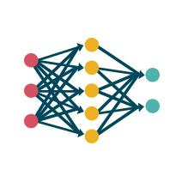
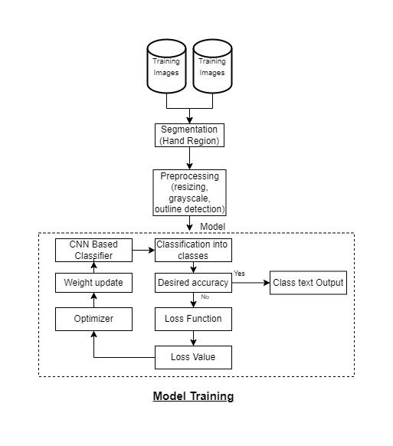
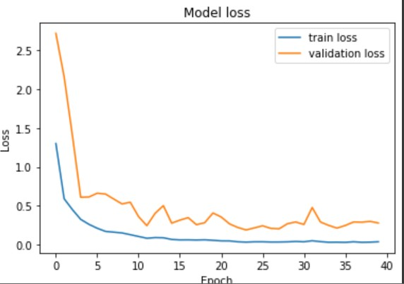
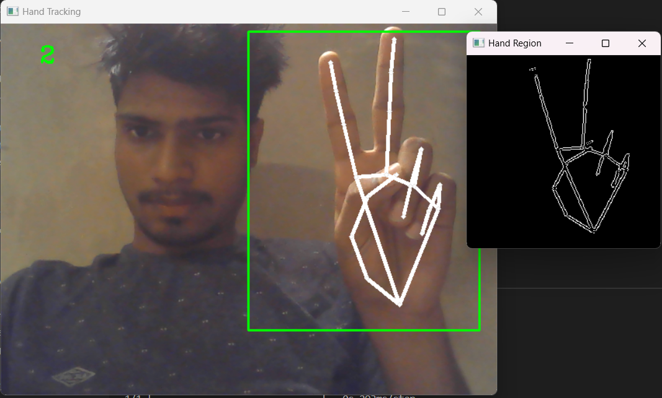
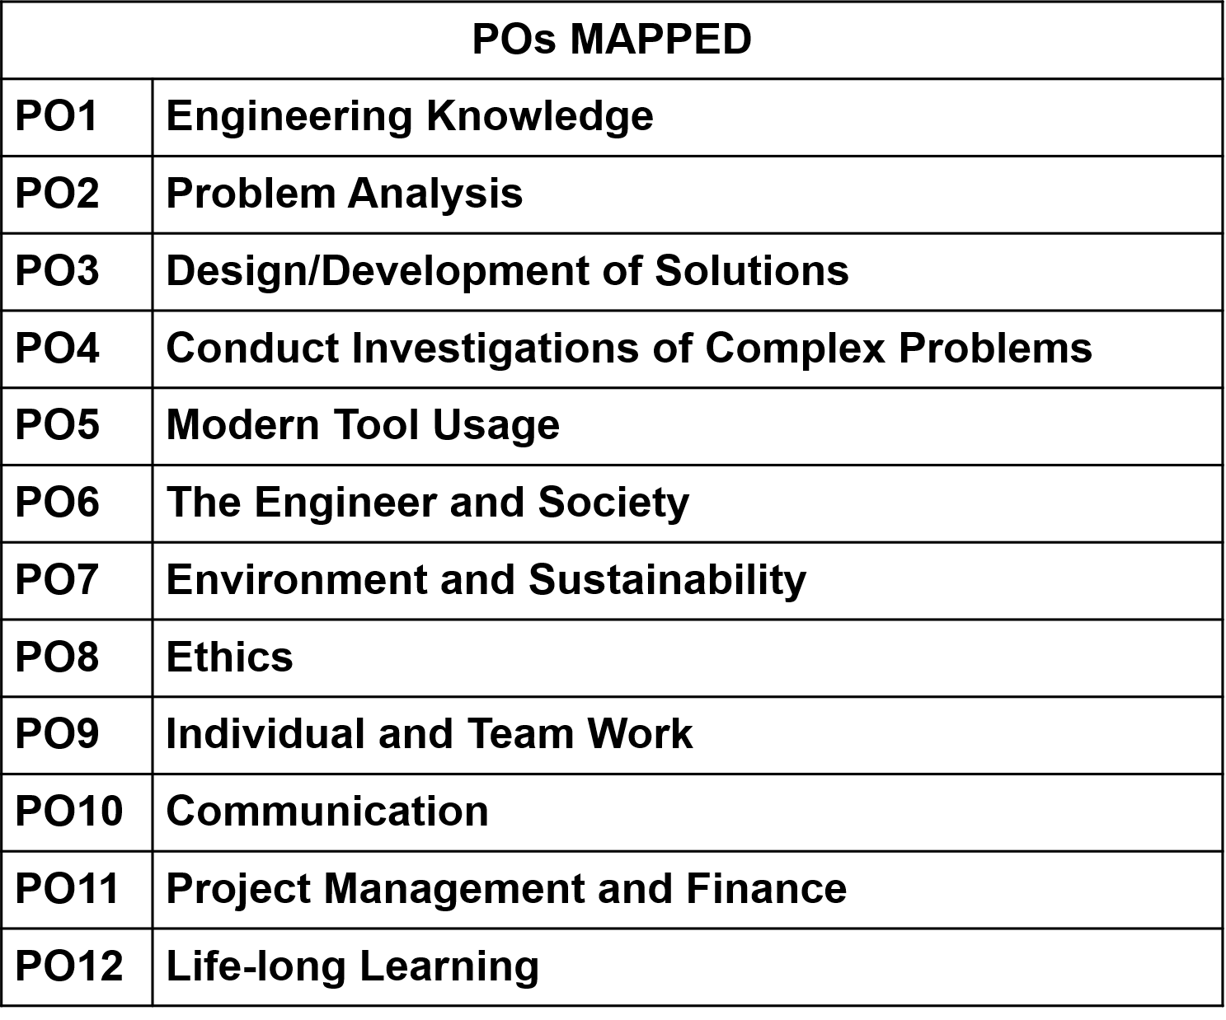
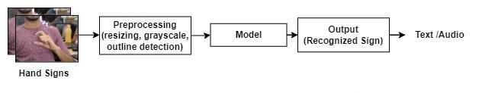
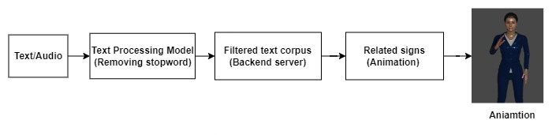
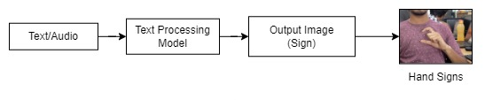
Department of Information Technology
IDENTIFICATION OF SIGN LANGUAGE
TEAM MEMBERS : ODRIN RODRIGUES, SHIVAM YADAV, KAUSTUBH DESLE, ANUSHKA SHINDE
UNDER THE GUIDENCE OF PROF. MEENA UGALE XAVIER INSTITUTE OF ENGINEERING, MAHIM
ABSTRACT
One of the non-verbal communication techniques utilized in sign language is the hand gesture. It is mostly used by deaf and dumb individuals to communicate with other people or among themselves when they have hearing or speech issues. Our model recognize the sign and display the text as the output. The recognition accuracy improved from hyper tuning with Keras and transfer learning.
INTRODUCTION
Deaf and hard-of-hearing persons use sign language, a visual-gestural language, to communicate. Hand gestures and other body movements are used to convey meaning. A platform converting sign language into text or speech providing environment for communication between normal and deaf and dumb community.
DESIGN
IMPLEMENTAION PROCESS
RESULTS AD GUI
VISION AND MISSION
To nurture the joy of excellence in the world of Information Technology. M1: To develop critical thinking ability of students by promoting interactive learning. M2: To bridge the gap between industry and institute and give students the kind of exposure to the industrial requirements in current trends of developing technology. M3: To promote leaning and research methods and make them excel in the field of their study by becoming responsible while dealing with social concerns. M4: To encourage students to pursue higher studies and provide them awareness on various career opportunities that are available.
CO’s ATTAINED
CO1: Identify problems based on societal/research needs and apply knowledge and skill to solve these problems in a group. CO2: Use standard norms of engineering practices to analyze the impact of solutions in societal and environmental context for sustainable development. CO3: Develop interpersonal skills and ethical awareness to work as a member of a group or leader and demonstrate capabilities of self-learning in a group, which leads to lifelong learning. CO4: Demonstrate project management principles during project work and Excel in written and oral communication.
POs Mapped
CONCLUSION
This method of AI predicting sign languages from a given frame will be useful for deaf individuals to communicate. This model makes advantage of the hand localization of posture area, which can identify hand segments while eliminating extraneous background noise. On static photos, our model performs 95% to 97% accuracy. Using architectures, such as an CNN and RNN combination, which process time series data effectively, will increase this method's ability to detect signs in real-time sign videos.
REFERENCES
1. G.Anantha Rao, K.Syamala, P.V.V.Kishore, A.S.C.S.Sastry, “Deep Convolutional Neural Networks for Sign Language Recognition.” , 2018. 2. Jie Huang, Wengang Zhou, Qilin Zhang,Houqiang Li, Weiping Li “Video-Based Sign Language Recognition without Temporal Segmentation”, AAAI-18, April 2018 3. M.A Hossen, Arun Govindaiah, Sadia Sultana, Alauddin Bhuiyan “Bengali Sign Language Recognition Using Deep Convolutional Neural Network” June 2018
Mission of Department of Information Technology
Input from camera
Preprocessing
Inverting Pixel’s
Transformed Image
Model
Model
Output

